Slide 1


Presentation on: HIGHCLOUDS AIRLINES DATA ANALYSIS PROJECT
This Photo by Unknown Author is licensed under CC BY
GROUP 5

Slide 2

Overview
The airline industry is a complicated sector that operates globally, encompassing major, regional, and low-cost carriers.
These airlines manage various fleets and operate within a complex ecosystem shaped by economic conditions, fuel prices, and regulatory standards. Revenue streams include passenger ticket sales, cargo transport, and ancillary services.
It is the dynamic industry influenced by various factors requiring adaptability, strategic planning and a commitment to safety and customer satisfaction for a long-term success Purpose of analyzing the data of airline industry serves as a fundamental tool for improving efficiency, making informed decisions, and staying competitive in a dynamic and challenging business environment.
It helps airlines navigate operational complexities, mitigate risks, enhance overall performance.
Data Analyzed in the form of relational, graphs and document data models using tools like Excel, Tableau, PowerBI and SQL Let examine the dashboards where we have used Load factor as the key for performance of the airlines
Notes:
This slide summarizes the full story upfront for leadership.

Slide 3

OBJECTIVE
3
1
FINANCIAL PERFORMANCE
The objective of conducting the High Cloud Airline analysis project is to understand the data and extract insights, communicating them to clients about the airline's performance, efficiency, and condition within the aviation industry.
RISK MANAGMENT
Ultimately, the goal of this analysis is to extract valuable insights that can inform strategic decisions for airlines and carriers. Whether it's optimizing flight schedules, improving operational efficiency, or understanding customer preferences.
2
MARKETING PERFORMANCE
Secondly, Our focus was to analyzing the dataset provided, the first step involves ensuring that the data is clean and ready for analysis. Once the data is prepared, we can dive into exploring its structure and relationships using various visualizations tools.

Slide 4
PREFERRED DEPARTURE

Slide 5
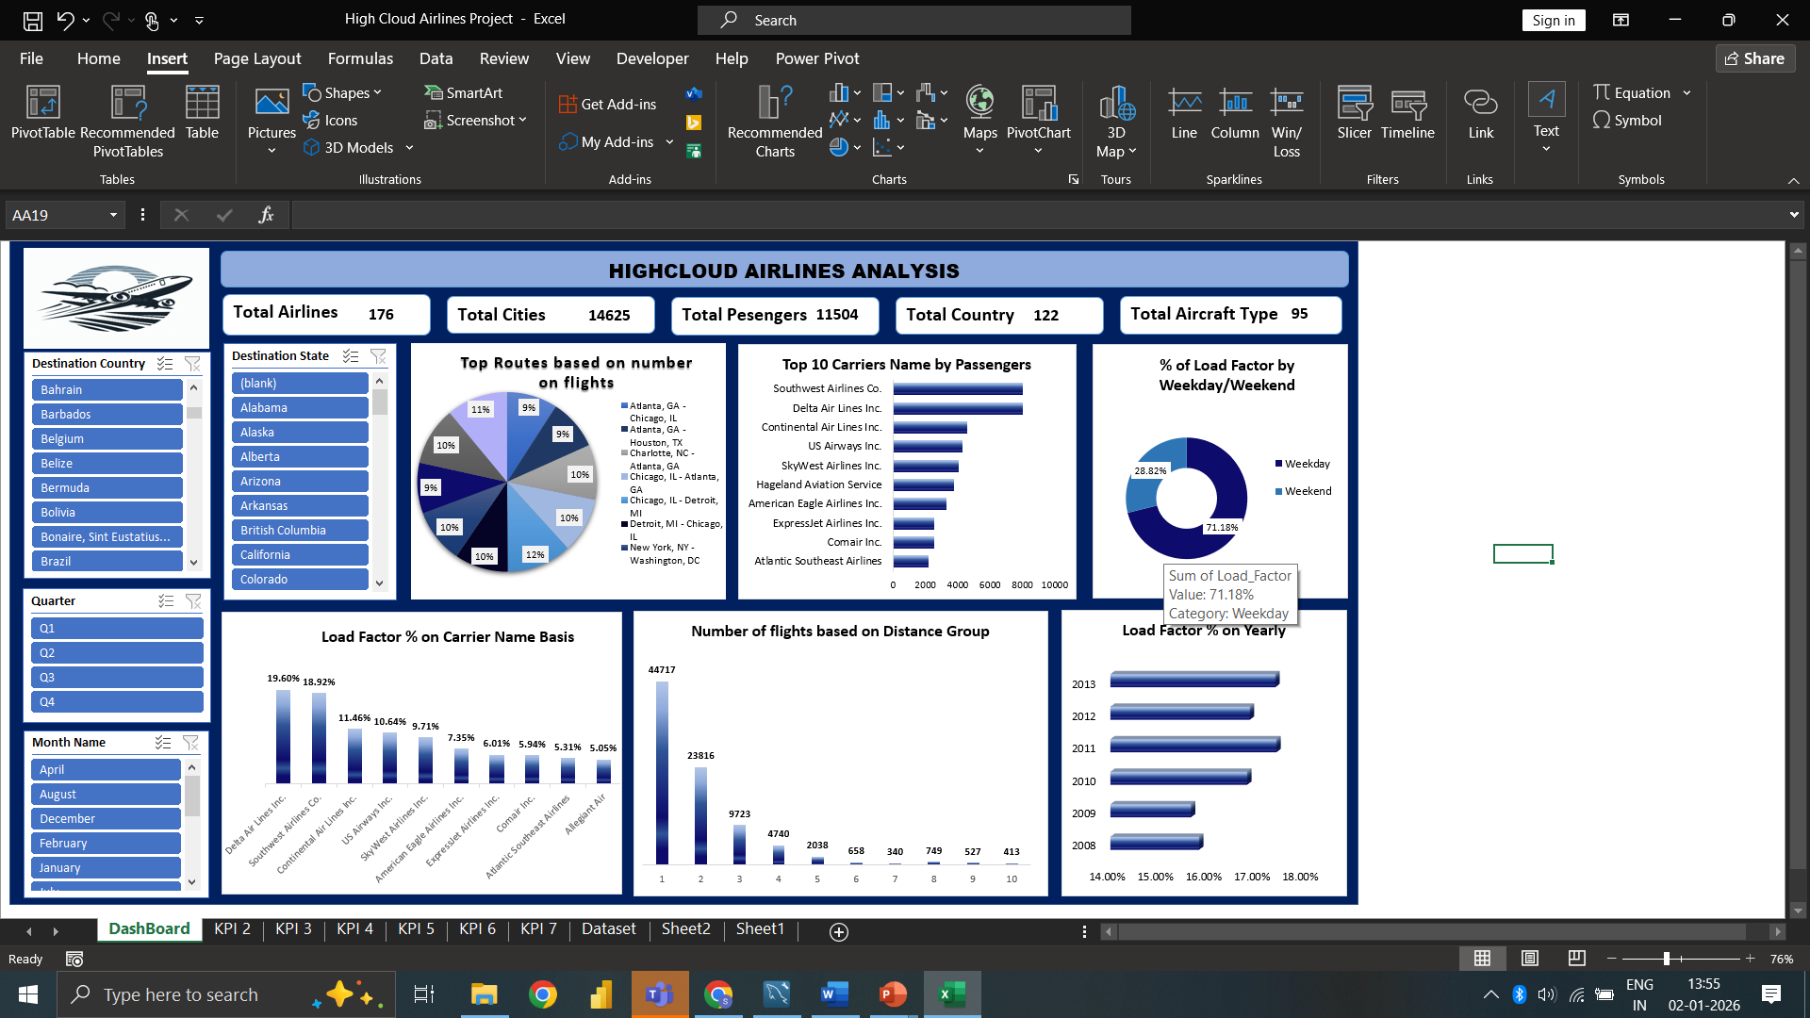
Excel dashboard

Slide 6
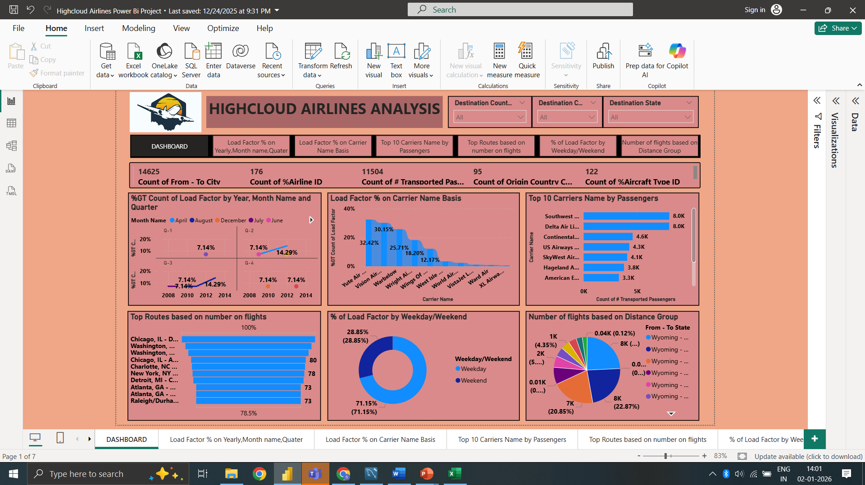
POWERBI DASHBOARD

Slide 7
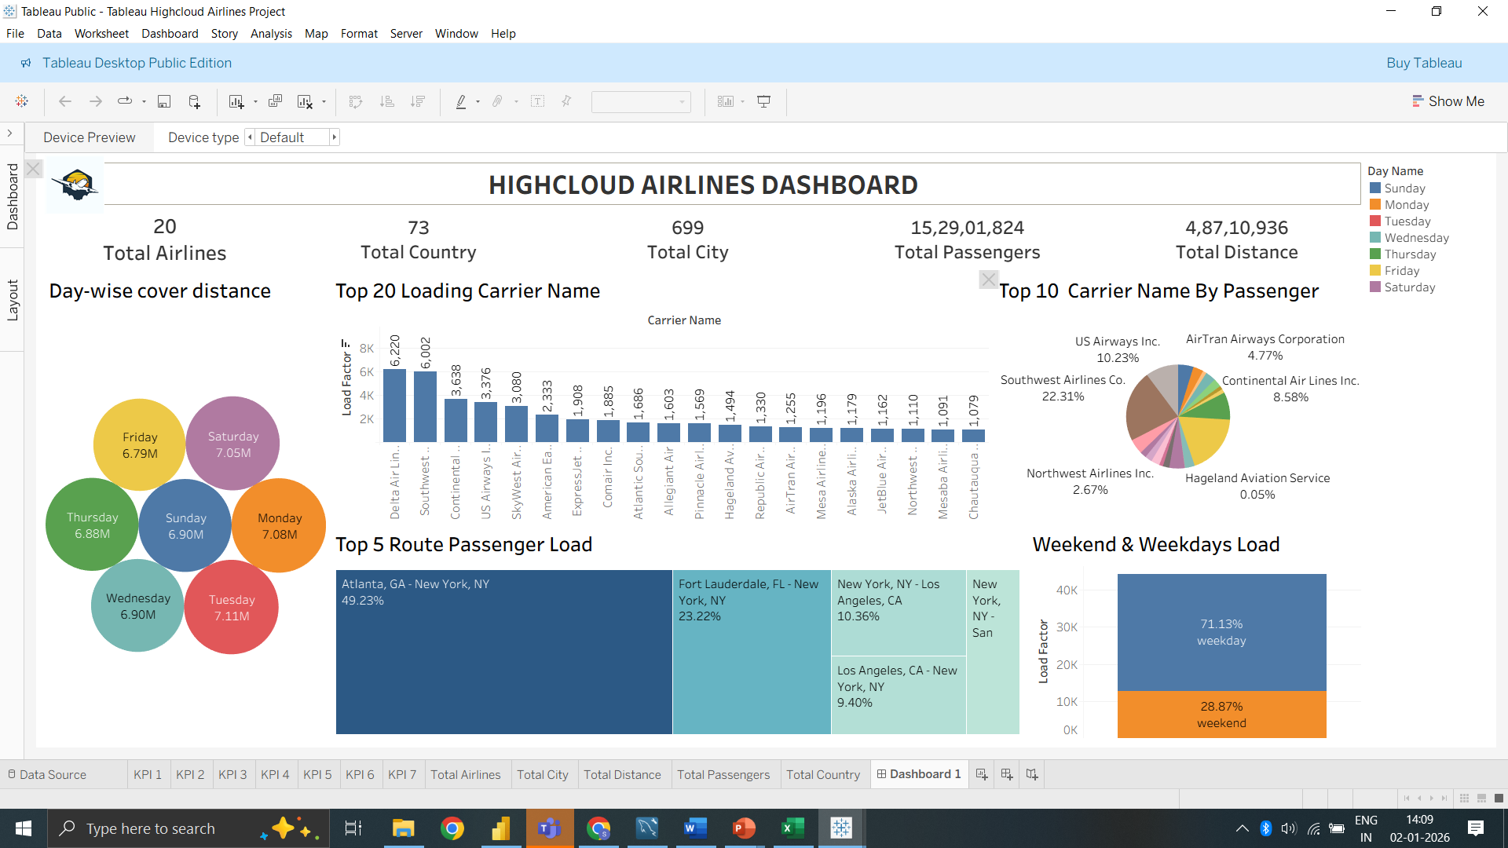
TABLEAU DASHBOARD

Slide 8
SQL
For SQL we have to use ‘airline maindata.sql’ file as provided.
With help of it our tables are created.
We and write queries and get output for it.
Below is our SQL file.
Project_file.sql

Slide 9

What we have learnt from this project
Load factor is a key metric used for benchmarking an airline's performance against competitors. Airlines may compare their load factors with industry averages to assess their relative position in the market.
Airlines use load factor data for strategic planning, route optimization, and fleet management.
As per the Analysis 2017(17.42) has the highest load factor and 2009(15.66) has the lowest load factor which directly impacts the airlines financial performance.
Operating with consistently low load factors may lead to financial loses, while maintain a high load factor contributes to profitability
Also, Delta Airlines Inc. has the highest load factor which is 19.60% with 8721 transported passengers
Airlines known for consistently high load factors may be perceived as operationally efficient and capable of maximizing revenue through effective capacity utilization and can be the successful in revenue generation
Passengers often associate crowded flights with popular routes and may choose carriers with higher load factors for a sense of reliability

Slide 10
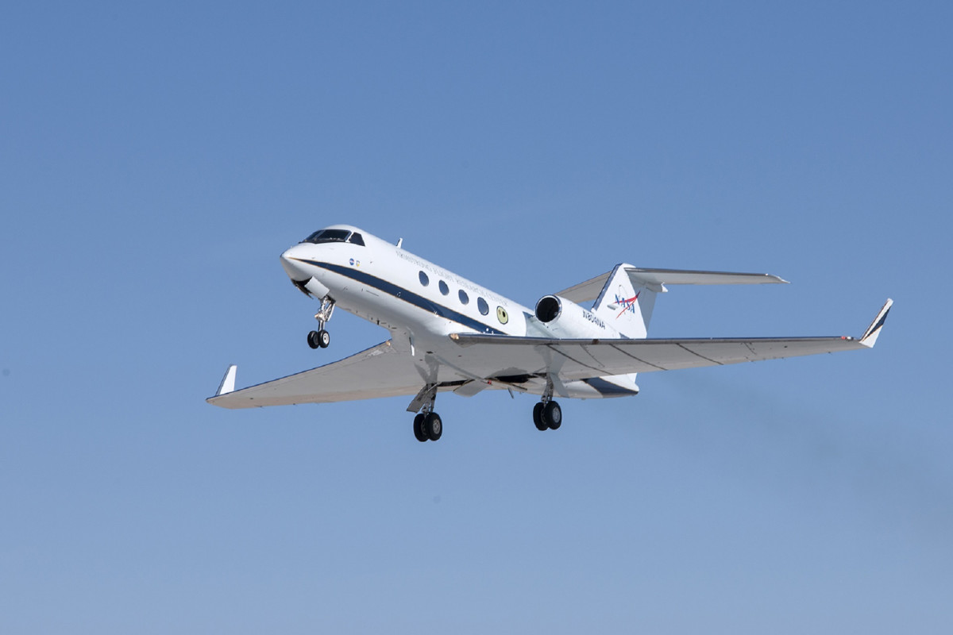
RECOMMENDATION
Optimize Flight Routes: Utilize insights from top routes and flights to optimize schedules and resource allocation.
Enhance Load Factor:
Leverage load factor analysis to identify trends and implement strategies for increased efficiency.
Strategic Carrier Partnerships: Collaborate with top carriers to maximize passenger transportation and enhance overall performance.
Resource Allocation:
Allocate resources strategically based on flight schedules and passenger volume data. This ensures efficient operations and minimizes wait times at airports with high passenger traffic.

Slide 11

PROJECT SCOPE
This project aimed to leverage the power of data analysis and extract valuable insights to optimize High Cloud Airlines operations and performance. The specific scope of the project focused on analyzing key performance indicators (KPIs) to gain a deeper understanding of:
Load Factor
Passenger Preferences
Popular Routes
Operational Efficiency

Slide 12

CONCLUSION
Analyzing airline data is pivotal for driving strategic decision-making, enhancing operational efficiency, and ultimately, fostering the overall success and competitiveness of the airline industry. By harnessing data analytics techniques, airlines can extract valuable insights from diverse sources such as passenger bookings, flight performance metrics, and customer feedback. These insights inform decisions across various domains including route optimization, pricing strategies, fleet management

Slide 13


